Slide 1
Computational Visual Perception Project Part – 2
Winter – 25/26
Name : Siddhant Vishvendu Sharma

Slide 2
1. Optical Flow & Motion Perception
We use RAFT (Recurrent All-Pairs Field Transforms) currently considered the gold standard for optical flow in the industry, we will attempt to investigate the following questions.
Q1 :Does RAFT hallucinate motion in static illusions, mirroring human vision ?
Q2 :In absence of texture on images does RAFT default to zero motion or exhibit random motion drifts ?
Q3 :Is RAFT’s response to illusions rotationally invariant, or does the flow direction rotate with image?

Slide 3
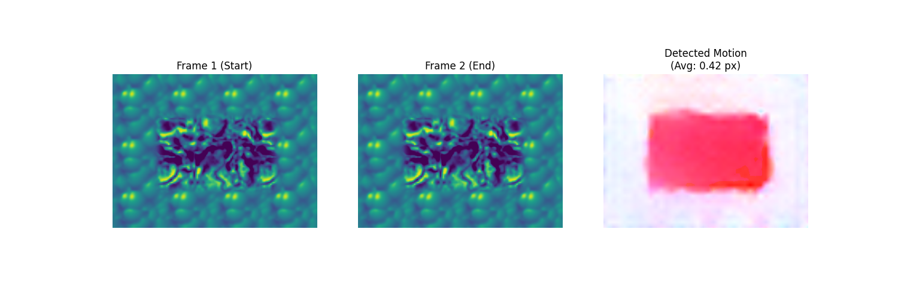
Verification of Local Implementation

Slide 4
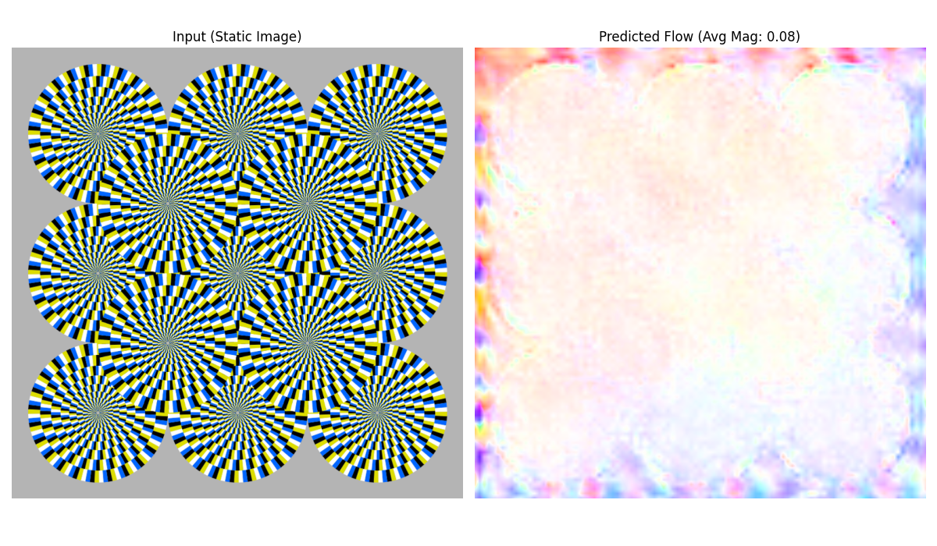
Test Case 1.1 : Rotating Snake

Slide 5
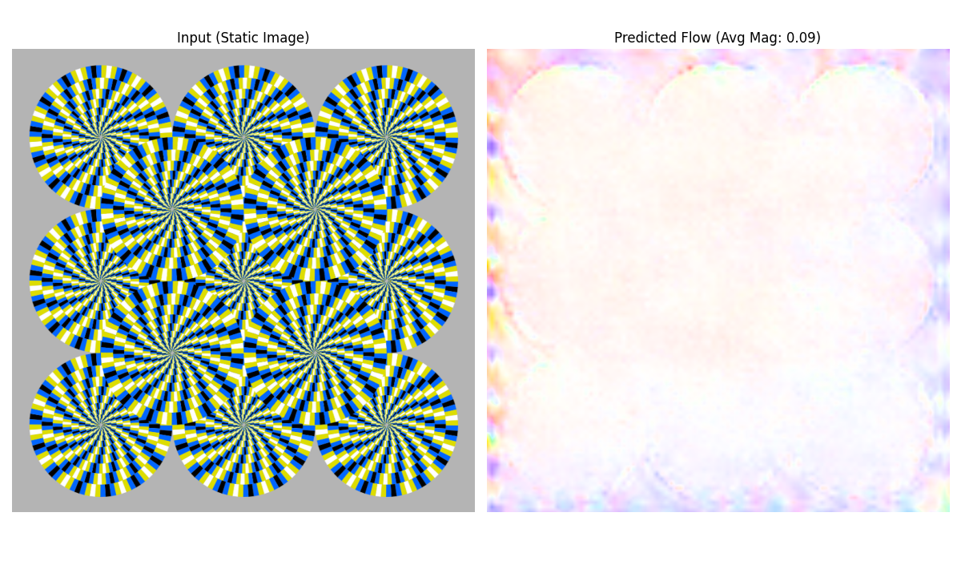
Test Case 1.2 : Colour Swapped Rotating Snake

Slide 6
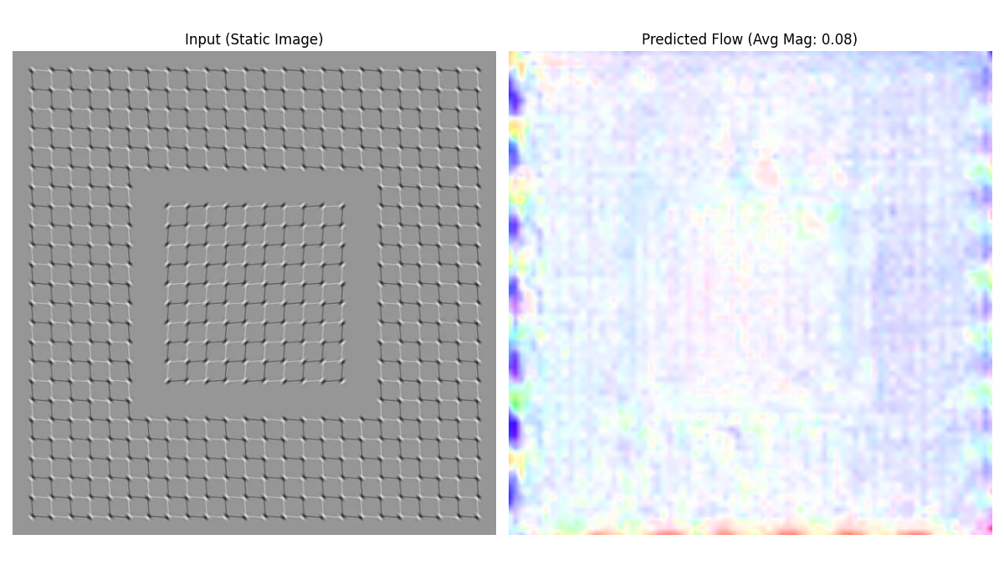
Test Case 1.3 : Drifting Emboss Illusion

Slide 7
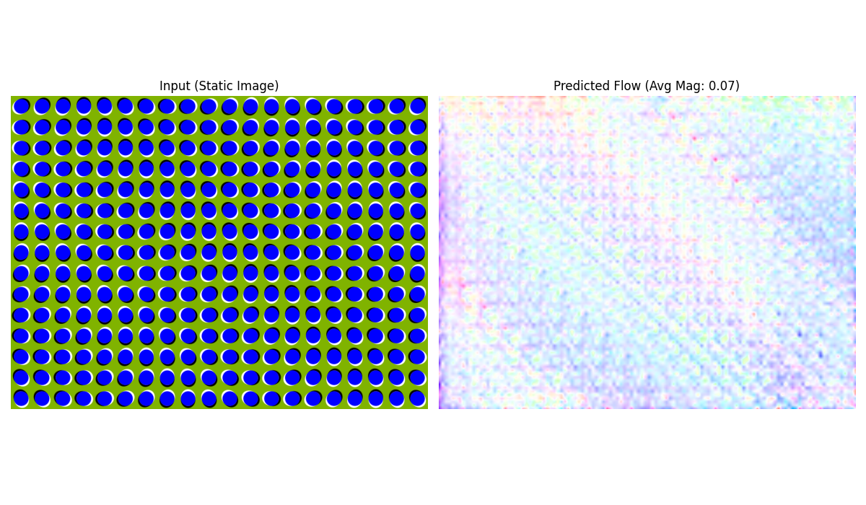
Test Case 1.4 : Anomalous Motion

Slide 8
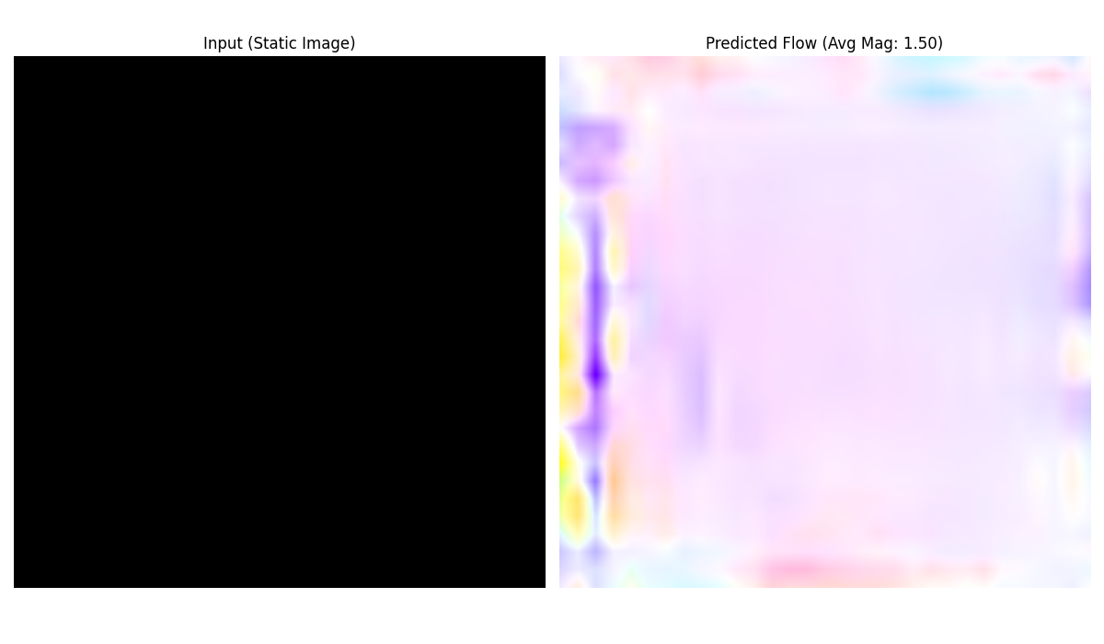
Test Case 1.5 : Pure Black Image

Slide 9
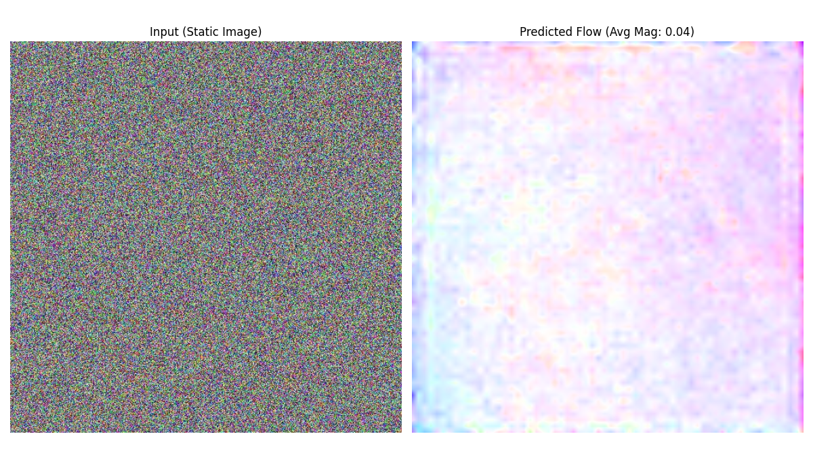
Test Case 1.6 : White Noise Image

Slide 10
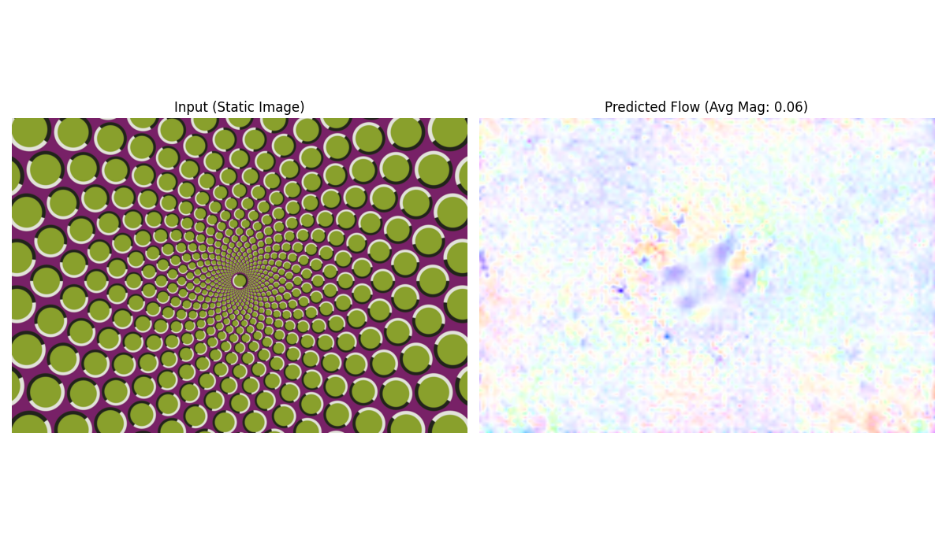
Test Case 1.7 : Repeated Pattern

Slide 11
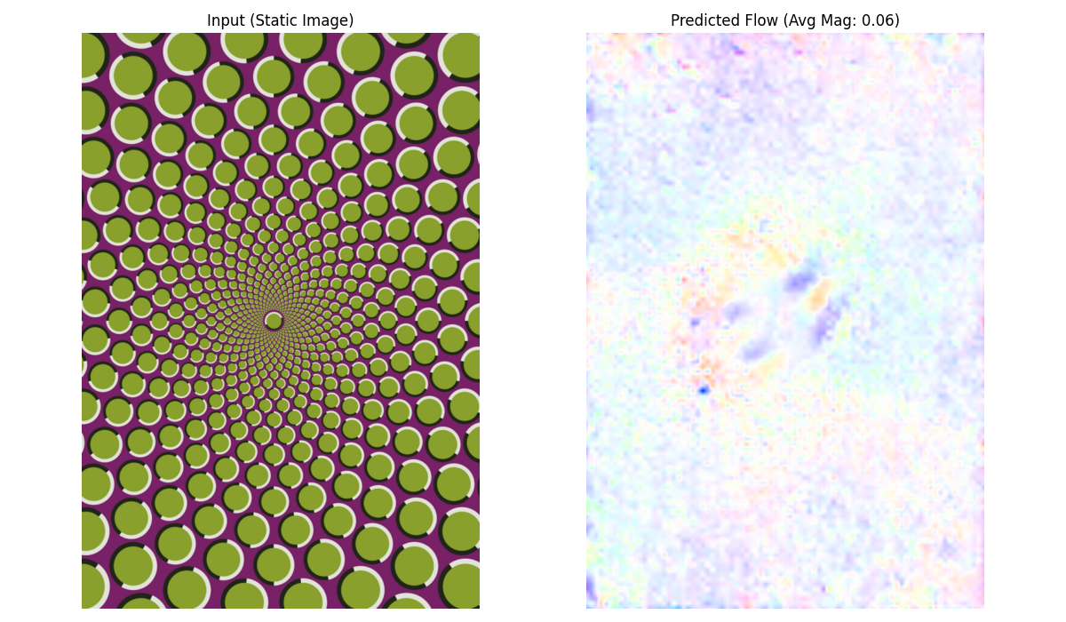
Test Case 1.8 : Repeated Pattern Rotated

Slide 12
Summary : Optical Flow with RAFT

Slide 13
2. Depth Estimation
We use DepthAnythingV2 currently considered the gold standard for depth estimation in the industry, we will attempt to investigate the following questions.
Q1 :Does the model interpret 2D forced-perspective art as physical geometry or a flat painted surface ?
Q2 :When presented with a mirror, does the model estimate depth to the glass surface or the virtual depth of the reflections?
Q3 :How does the model resolve the geometry of an Escher style object that cannot exist in 3D space?

Slide 14
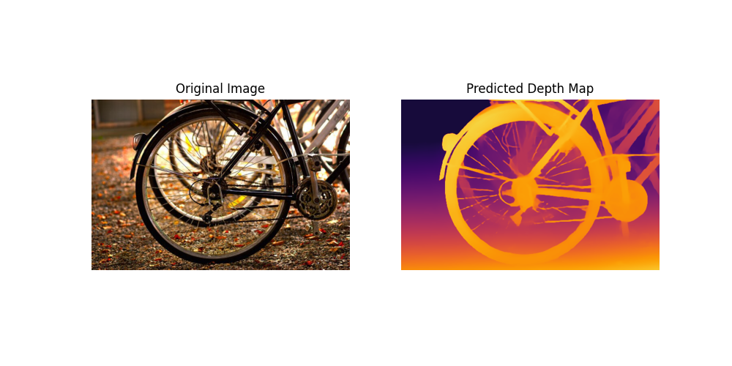
Verification of Local Implementation

Slide 15
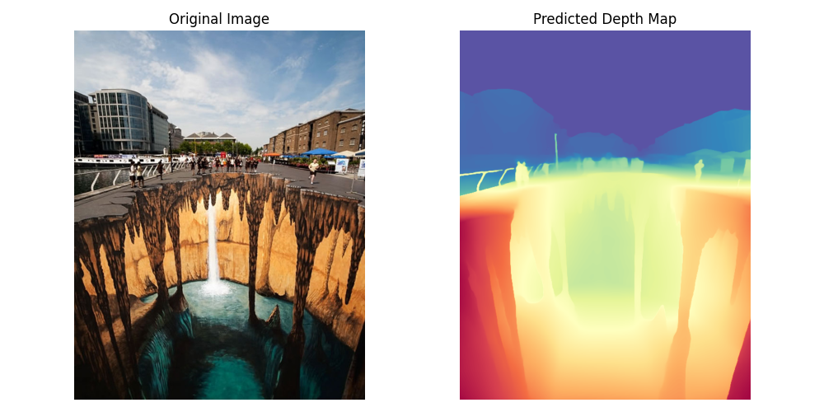
Test Case 2.1 : 3D Chalk Art

Slide 16
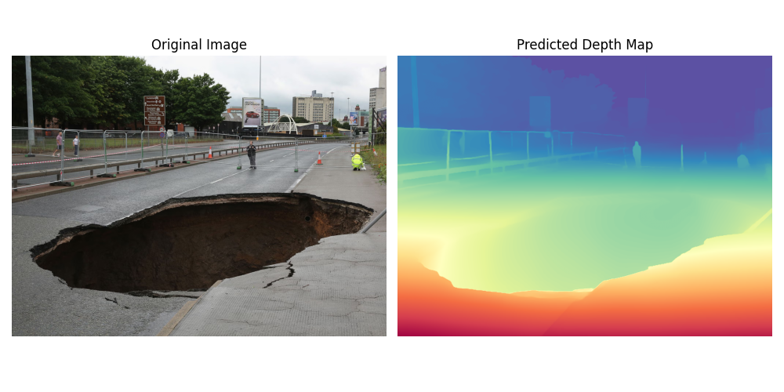
Test Case 2.2 : Real Sinkhole in Road

Slide 17
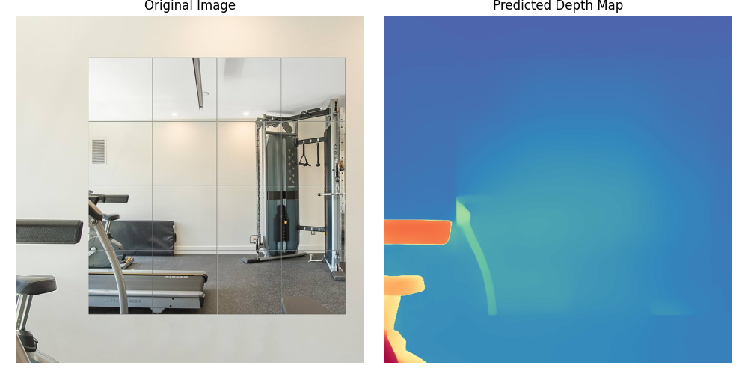
Test Case 2.3 : Mirror on the Wall

Slide 18
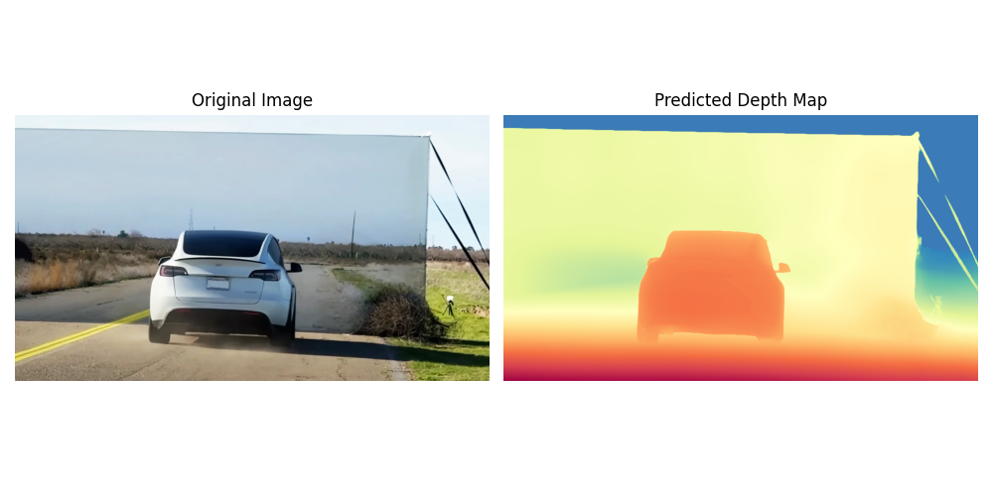
Test Case 2.4.1: Famous Tesla Wall Test

Slide 19
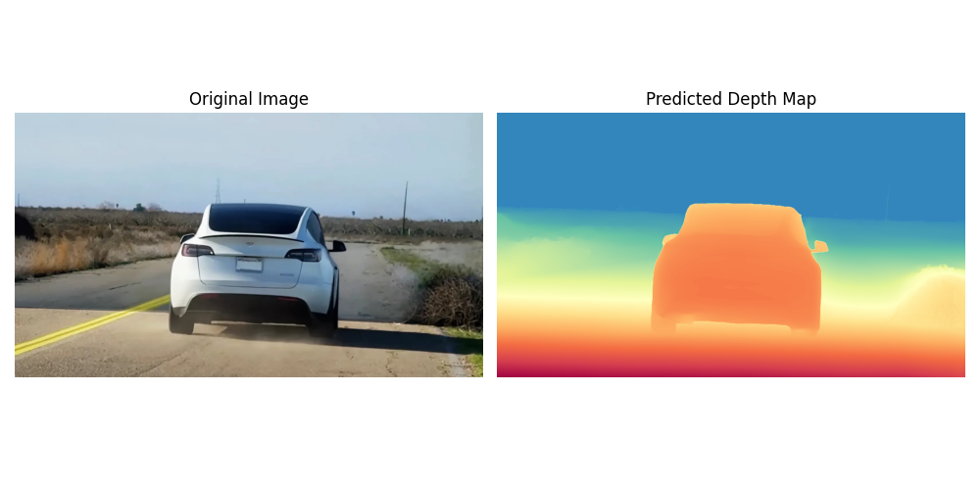
Test Case 2.4.2 : Tesla Wall Test Cropped

Slide 20
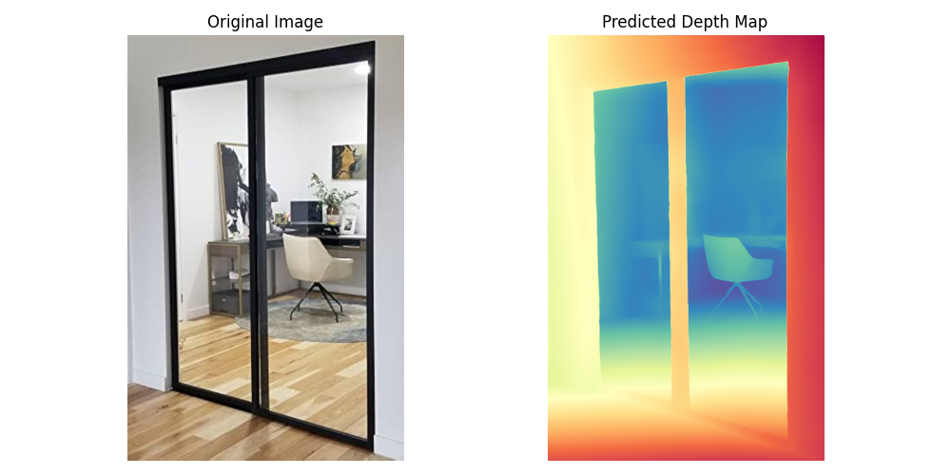
Test Case 2.5 : Transparent Glass Door

Slide 21
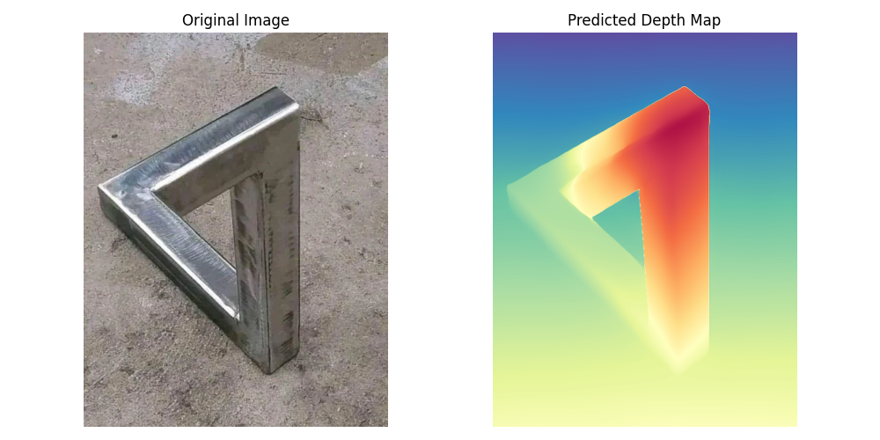
Test Case 2.6 : Penrose Triangle

Slide 22
Test Case 2.6 : Penrose Triangle

Slide 23
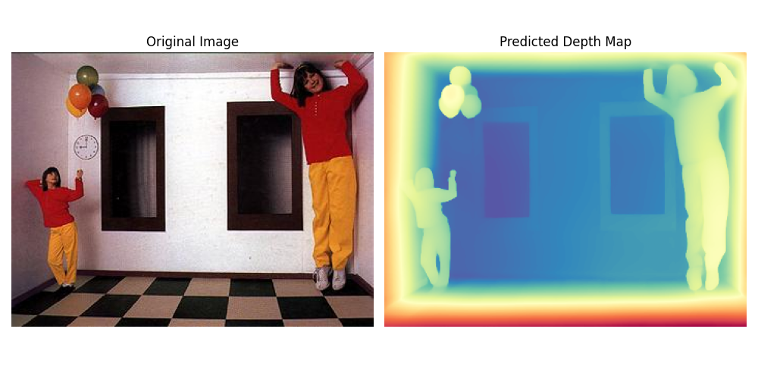
Test Case 2.7 : Ames Room

Slide 24
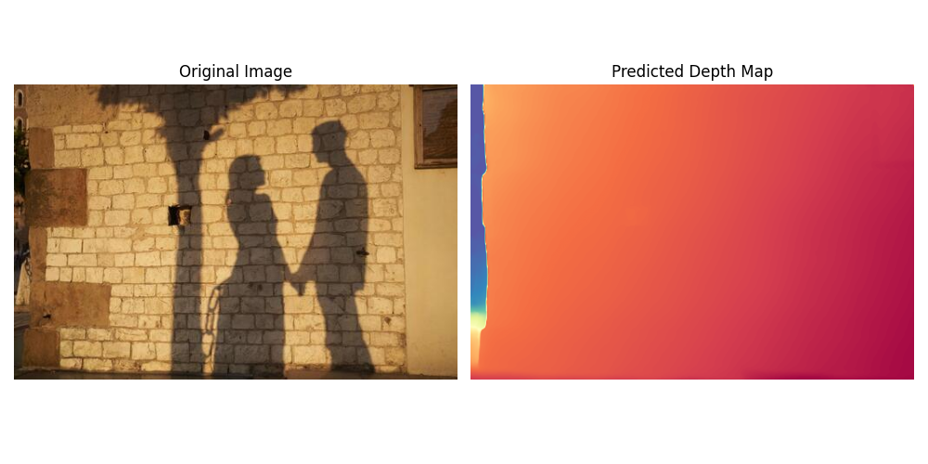
Test Case 2.8 : Shadow on Wall

Slide 25
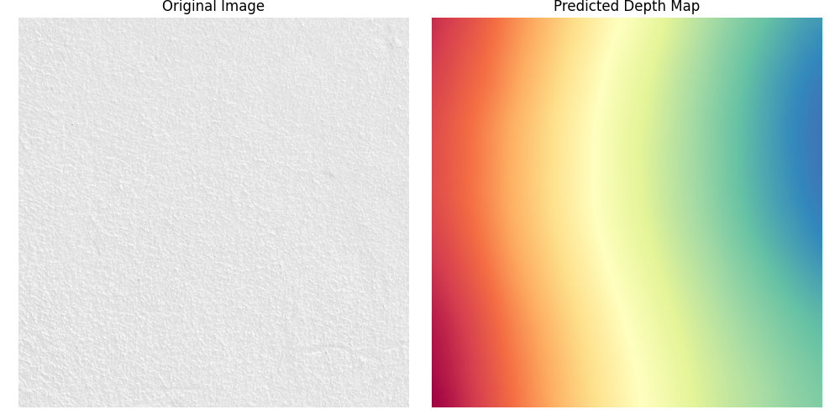
Test Case 2.9 : Flat White Wall

Slide 26
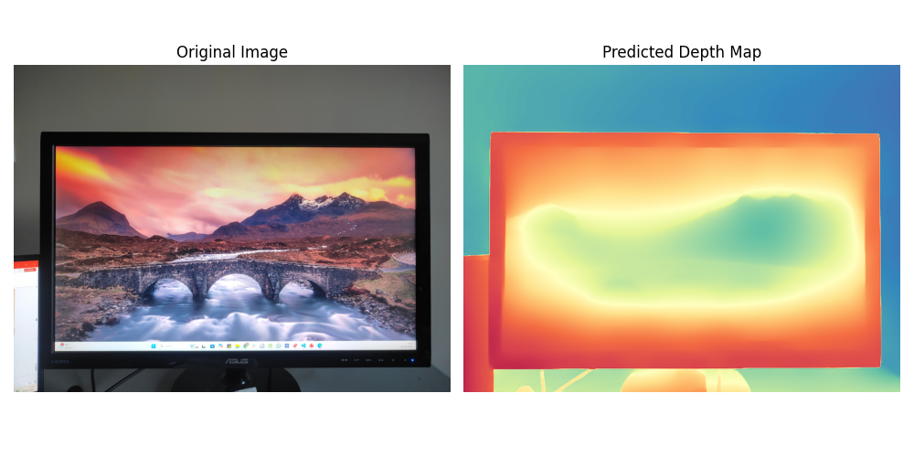
Test Case 2.10.1 : Screen with a Landscape

Slide 27
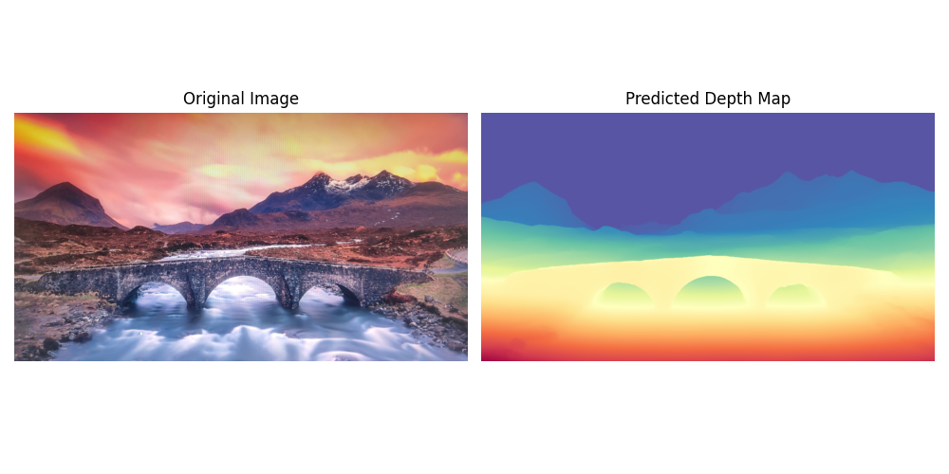
Test Case 2.10.2 :Screen with a Landscape Crop

Slide 28
Summary

Slide 29
3. Segmentation
We use SAM2 due to computational limits of my local implementation and there was not a significant difference observed between SAM2 vs SAM3 when comparing image only based segmentation (no text or prompt was provided to avoid bias of looking for a particular object) and the confidence was set to 25%, we will attempt to investigate the following questions.
Q1 :Does SAM2 demonstrate Gestalt principle of ‘Closure’ by segmenting objects defined only by missing information?
Q2 :Can SAM2 model group disconnected features into a single semantic entity eg. Dalmatian in spots?
Q3 :Does the model perceive an object occluded by a bar as one single object or two separate parts?

Slide 30
Test Case 3.1 :

Slide 31
Test Case 3.1 :

Slide 32
Test Case 3.1 :

Slide 33
Test Case 3.1 :

Slide 34
Test Case 3.1 :

Slide 35
Test Case 3.1 :

Slide 36
Test Case 3.1 :

Slide 37
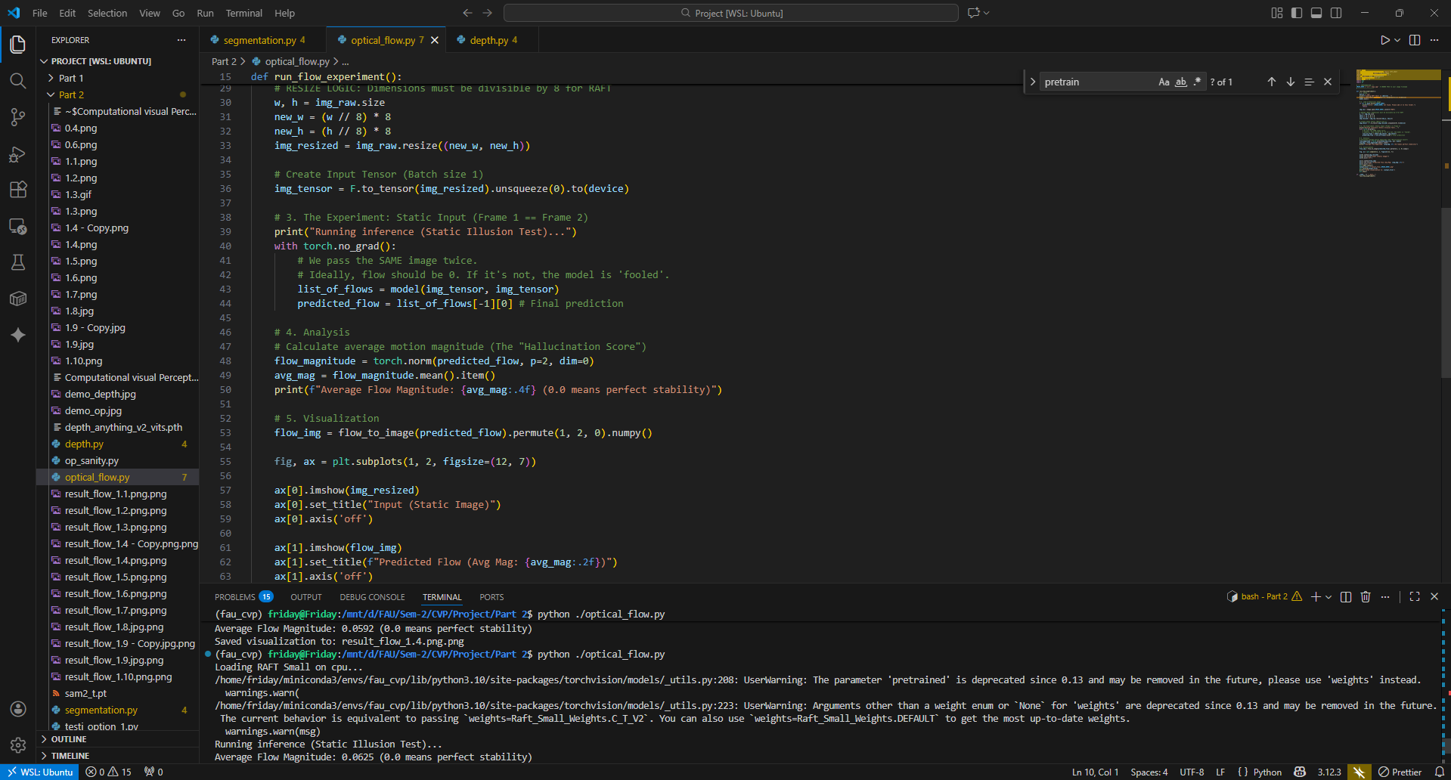
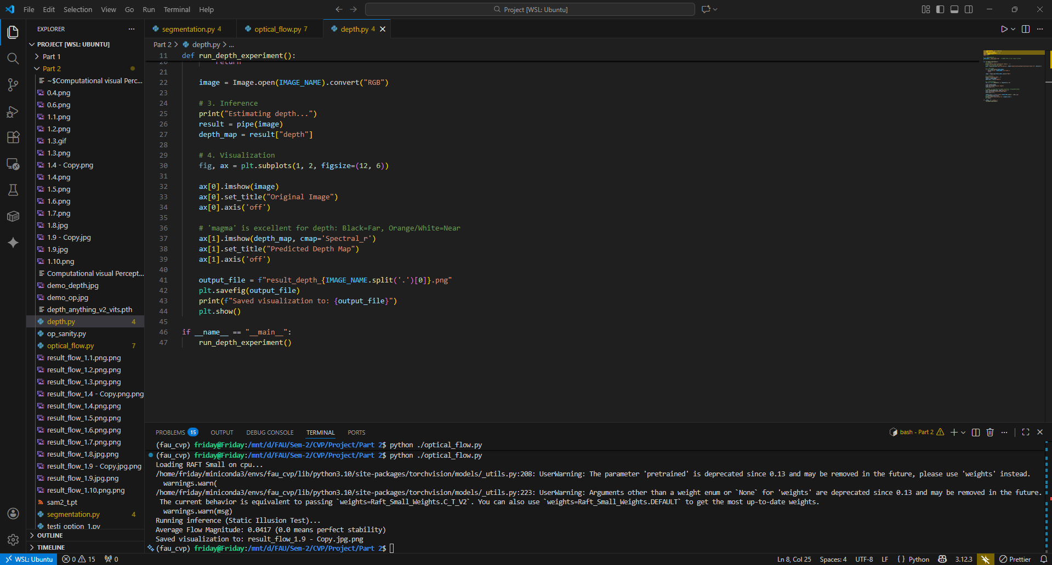
Local Implementation All the scripts and images can be found on my repo : https://github.com/code-barrage/FAU_CVP_Project-WiSo25-26

Slide 38
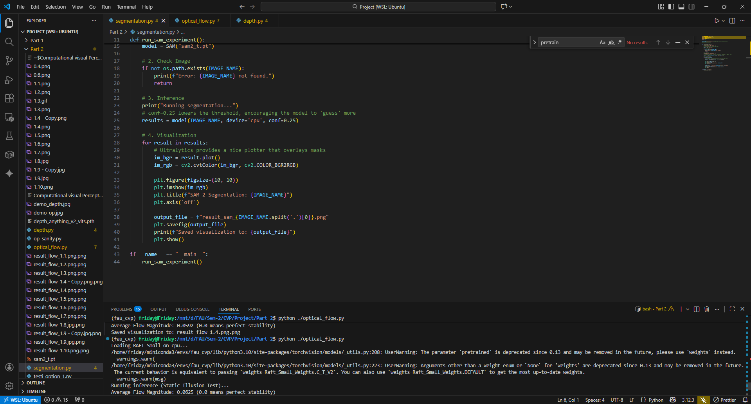

Slide 39
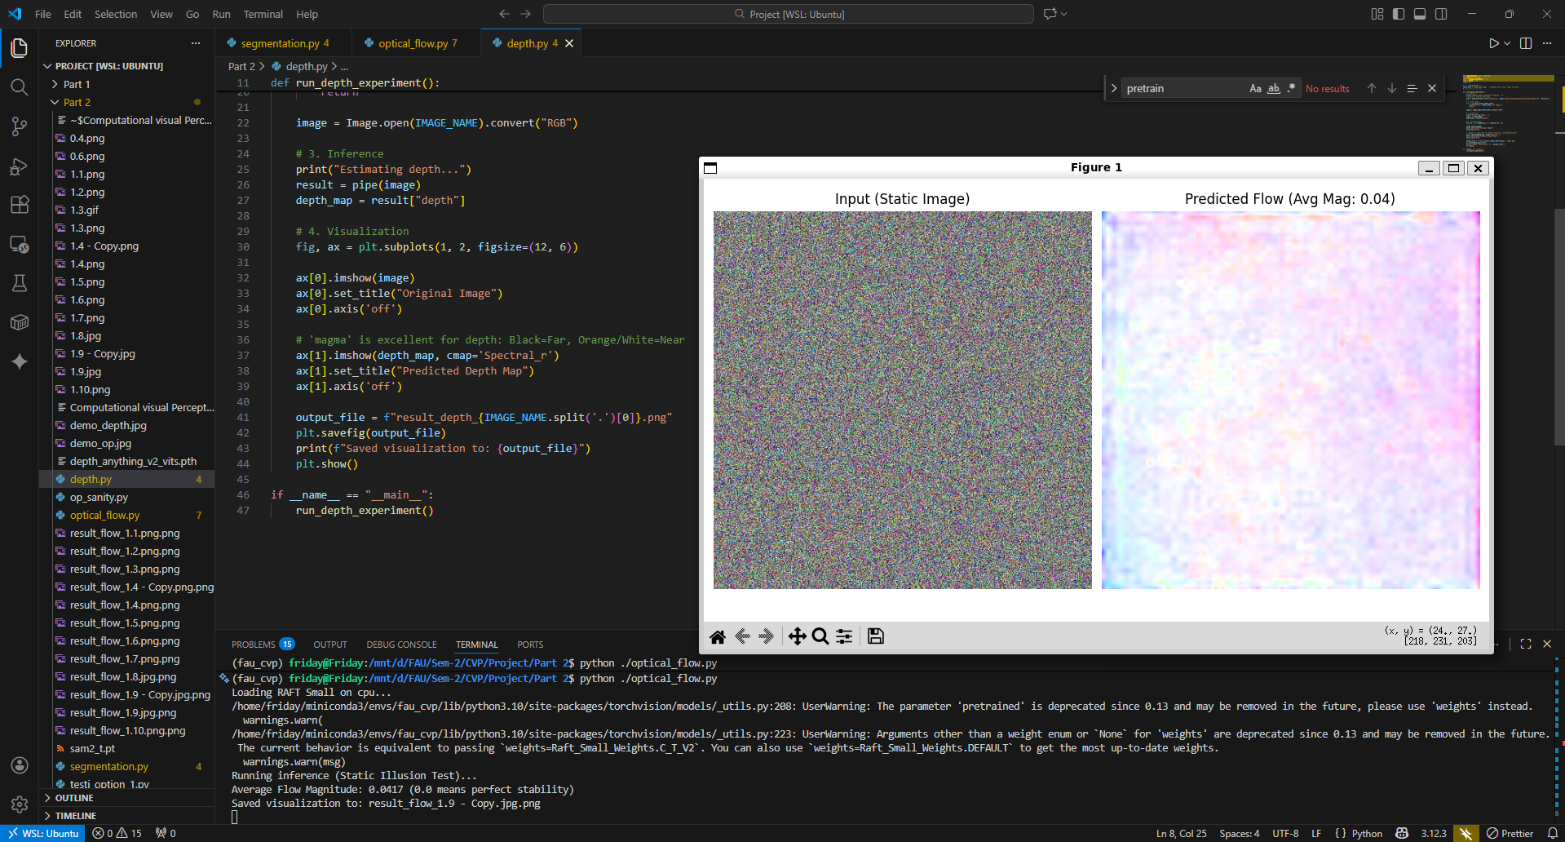

Slide 40
References and Courtesy
https://www.ecva.net/papers/eccv_2020/papers_ECCV/papers/123470392.pdf
https://michaelbach.de/ot/mot-snakesLum/
https://journals.sagepub.com/doi/10.1177/20416695211018720
https://www.psy.ritsumei.ac.jp/akitaoka/saishin57e.html
https://www.reddit.com/r/illusionporn/comments/1ptwxbq/a_ceiling_art_that_looks_like_moving/?utm_source=share&utm_medium=web3x&utm_name=web3xcss&utm_term=1&utm_content=share_button

